Slide 1
Final Pitch Deck Template

Slide 2
Here’s the Problem

Slide 3
Problem Statement
Establish the public health problem
Cite literature, use figures

Slide 4
Flourishing Gap
Highlight the flourishing gap
Describe consequences/tradeoffs
Cite literature

Slide 5
Here’s Our Solution

Slide 6
Description of Solution
Intended Use
Design Methods

Slide 7
End User Research
Target user group
Who did you speak to?
What did they say?
How did those insights inform your design?

Slide 8
Demo
Walkthrough of the solution

Slide 9
Testing and Validation Plan
Describe how you’ll test that your solution will work
Identify potential experts and partners
Ethics review and considerations

Slide 10
Market Research

Slide 11
Market Potential
What is the market size?
Are there projections for growth?

Slide 12
Potential for Growth
Sustainable Scaling Plan

Slide 13
Comparison to Competitors
​ | Your Tool​ | Competitor 2​ | Competitor 3​
Feature 1​ | ​ | ​ | ​
Feature 2​ | ​ | ​ | ​
Feature 3​ | ​ | ​ | ​
Feature 4​ | ​ | ​ | ​
Feature 5​ | ​ | ​ | ​
​ | ​ | ​ | ​

Slide 14
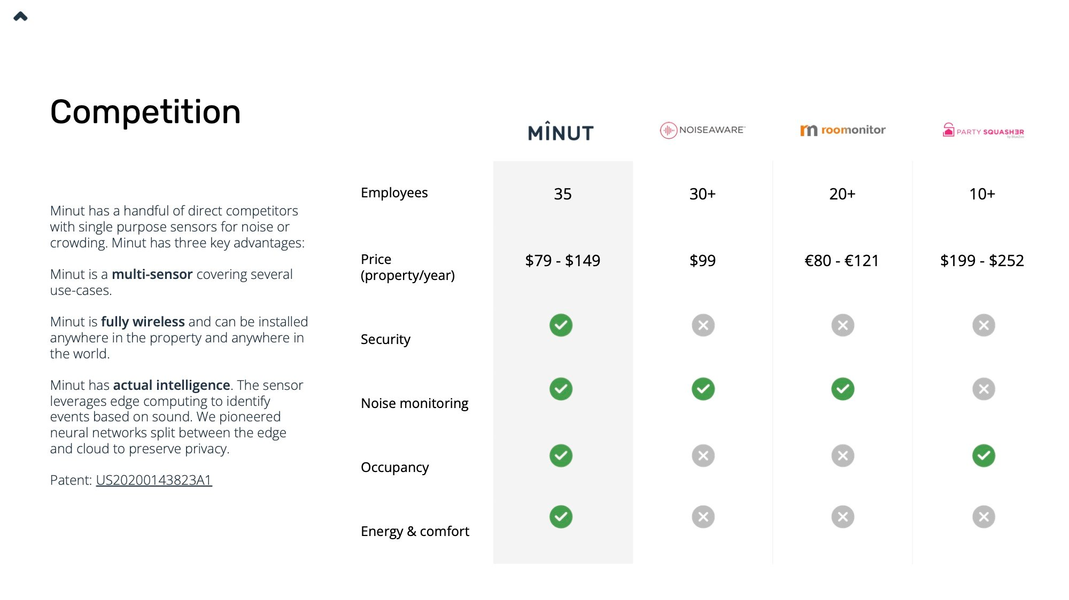
Competition Slide Example

Slide 15
Executive Summary
High-Level Takeaways
End with slogan

Slide 16
Our Team
Image
Image
Image
Name
Role
Name
Role
Name
Role

Slide 17
Thank You!
Questions?

